Slide 1
Introduction to Software Engineering
Module 6-a
Architectural Design – the Subsystem & Module levels
Dr. Shai Koenig
Open University
Department of Computer Science

Slide 2
Document Control
Changes
Added a slide on required readings
Merged subsystem and module levels into a single presentation
ToDo/Ideas/Open Issues
Add the “independent components” architectural style
add more on comparing architectural styles [use Bass]
add some info on real-time architectural patterns
Add configuration view
Add the concept of viewtypes and views in general

Slide 3
Document Control
Changes
added a second form of context diagram
hid the subsystem slides to create a presentation on module design [this assumes that this unit is preceded by a presentation on subsystem-level design]
Added a slide on references
ToDo/Ideas/Open Issues
Add an example system to illustrate the ideas. perhaps use Sommerville.
Perhaps adapt to UML notation
perhaps adapt to object-oriented
perhaps use the cruise control system or the bouy system
Add material on parametrized ADT’s – perhaps using ADA generics
Replace the term “package” with the term “module”

Slide 4
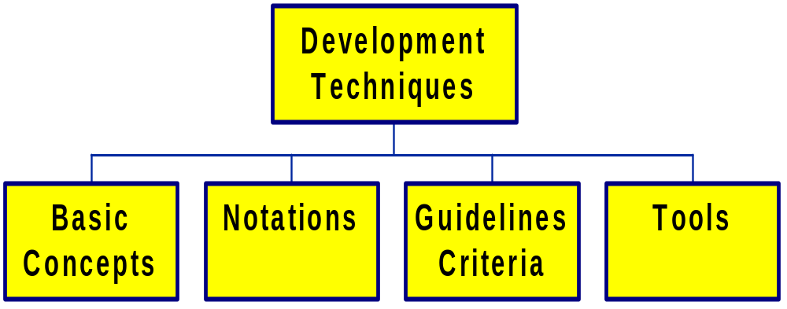
Development Techniques

Slide 5
Required Readings
Readings for Module 6:
  Software Design - Concepts and Principles
  compiled by Shai Koenig,
  Open University,
  Spring 1999
Chapter 1 - Introduction to SW Design
Chapter 2 - Architectural Design
Chapter 3 - Modular and OO Design
Chapter 4 - Structured Design

Slide 6
Outline
Architectural Design Components
  Subsystems
  Modules
  Routines
Architectural Design Process
The Subsystem Level
  Subsystems
  Sub-system decomposition and structuring
  Architectural Design Patterns
  Domain Specific Architectures
The Module Level
  Modules
  Modular decomposition and structuring
  Module Taxonomy

Slide 7
Starting Point - Context Diagram
External
Entity
a
b
SW (Sub) System
Under Requirements
Specification
External
Entity
c
d
External
Entity
Interfaces
a - ...
b - ...
c - ...
d - ...
Requirements
…
…
…

Slide 8
Starting Point - Context Diagram
External
Entity
a
b
SW SubSystem
Under Requirements
Specification
External
Entity
c
e
d
f
SW SubSystem
Under Requirements
Specification
SW SubSystem
Under Requirements
Specification
Interfaces
a - ...
b - ...
c - ...
d - ...
g
Requirements
…
…
…
External
Entity

Slide 9
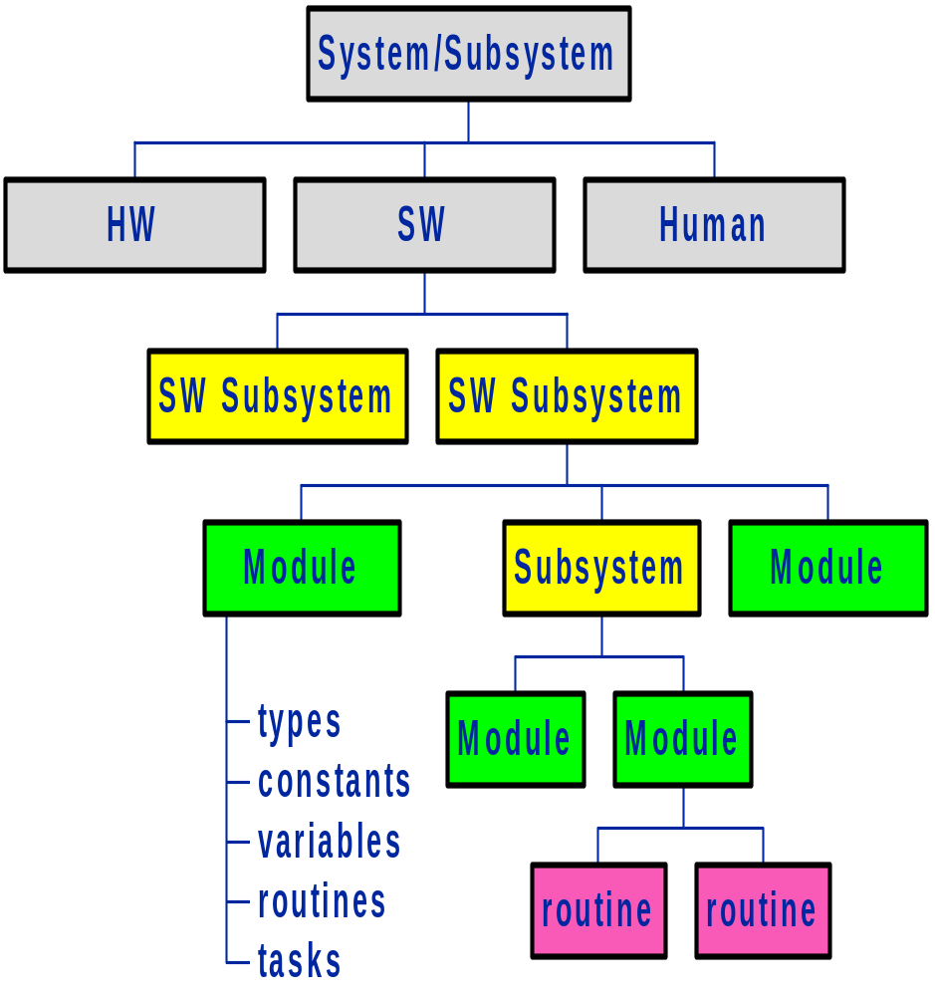
SW Design Components - Example

Slide 10
Introduction to Modules
Routines
Functional black boxes
Granularity Too Small
Languages:
  Fortran , Algol, PL/I, Pascal, C
Building Blocks of Structured Design
Decomposition Criteria
  functional decomposition
Modules [Packages]
Collection of program entities
  constants
  types
  variables
  routines
Distinguishes between
  public entitites
  private entitites
Languages:
  Ada, Modula-2, C++, Java
Building Blocks of
  Object-based design
  Object-oriented design
Decomposition criteria
  localization
  abstraction/ information hiding
  concurrency

Slide 11
Module - The Public Side
routine
spec
routine
spec
routine
spec

Slide 12
Module - The Private Side
Module-level
data
routine
spec
routine
body
routine
body
routine
spec
routine
body
routine
body
routine
spec
routine
body
routine
body

Slide 13
Subsystems
A software system will typically contain many
thousands of parts, such as
types
constants
variables
routines
tasks
mailboxes
semaphores
...
files
relations
databases
interfaces
exceptions
screens
Modules are too small to organize and structure all of a system’s elements.
Subsystems provide a level of structuring and abstraction between the system and the module level.
Subsystems provide structuring of
    the software
    the development process
    the design documentation
    the design organization
    the management process

Slide 14
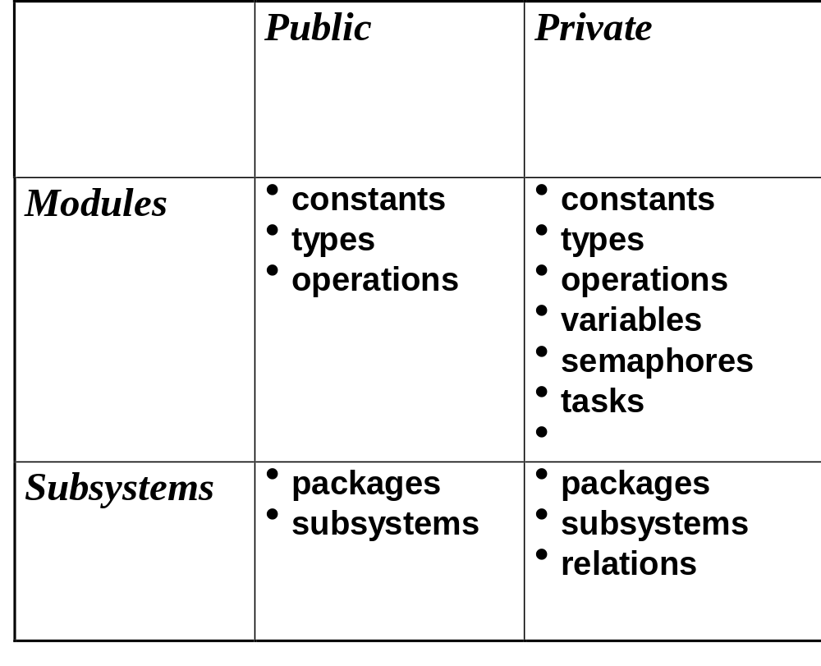
Subsystems
Subsystems are collections of components
  subsystems
  modules
  databases
and their interfaces
Subsystems have an outside and an inside

Slide 15
Outline
Architectural Design Components
  Subsystems
  Modules
  Routines
Architectural Design Process
The Subsystem Level
  Subsystems
  Sub-system decomposition and structuring
  Architectural Design Patterns
The Module Level
  Modules
  Modular decomposition and structuring
  Module Taxonomy

Slide 16
Architectural Design Process
Establishing the overall structure of a software system
Sub-system decomposition and structuring
  The system is decomposed into several principal sub-systems
  interfaces and communications between these sub-systems are identified
  control relationships between the different parts of the system is established
  logical database schema is defined for persistent data
Modular decomposition and structuring
  The identified sub-systems are decomposed into modules
  modules are specified in terms of their exported services
  “uses” relationships between modules are defined
  tasks [i.e., processes, threads of control] are identified

Slide 17
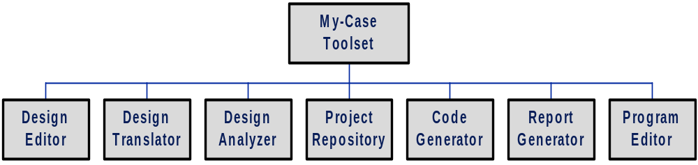
Subsystem Structuring
Concerned with decomposing the system into sub-systems
Sometimes called
the Static view or
Logical view

Slide 18
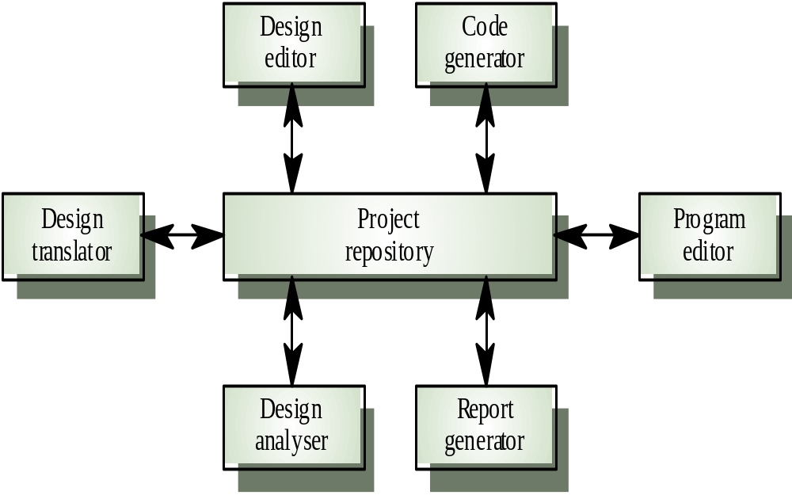
Subsystem Structuring
Concerned with decomposing the system into sub-systems
Data-flow [inter-subsystem communication], control flow and persistent data issues are addressed
The architectural design is normally expressed as a block diagram presenting an overview of the system structure
Sometimes called
the Dynamic view

Slide 19
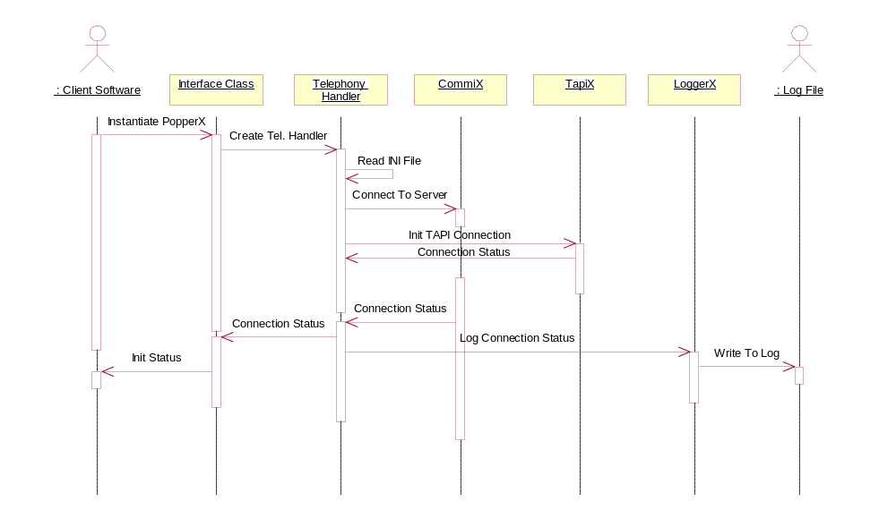
Subsystem Structuring
Concerned with decomposing the system into sub-systems
Data-flow [inter-subsystem communication], control flow and persistent data issues are addressed
The architectural design is normally expressed as a block diagram presenting an overview of the system structure
Interaction diagrams may be used to illustrate subsystem-level interactions [e.g., UML sequence diagrams or collaboration diagrams]

Slide 20
Context Diagram
functional requirements
non-functional requirements
external interfaces
System

Slide 21
Subsystem Structuring
decomposition into subsystems
allocation of requirements
allocation of external interfaces
definition of “internal” interfaces
System
Subsystem
Subsystem
Subsystem

Slide 22
Module Decomposition and Structuring
decomposition into modules
allocation of requirements
allocation of external interfaces
definition of “internal” interfaces
System
Subsystem
Subsystem
Subsystem

Slide 23
Module Decomposition and Structuring in UML
My package
<<subsystem>>
A
<<subsystem>>
B
C
+ aPublicClass
+ anotherPublicClass
aPrivateClass
# aProtectedClass
<<subsystem>>

Slide 24
UML Deployment Diagram
IIOP
COM
<<AS400>>
<<Wintel>>
Billing
Kiosk
Server
PC
<<campus LAN>>
<<campus LAN>>
<<NT>>
<<campus LAN>>
<<Sun>>
Middle Tier
Course Catalog
Server
Server
<<dialup>>
<<campus LAN>>
<<Wintel>>
Web
Workstation
<<Sun>>
DB
HTTP
ODBC
Server

Slide 25
Subsystem Decomposition Criteria
function, service, processing
shared resource
interface with external entity
  user interface
  sensors, affectors
control
physical organization
reuse
  off-the-shelf components
  existing assets
  planned reuse
temporal considerations

Slide 26
Outline
Architectural Design Components
  Subsystems
  Modules
  Routines
Architectural Design Process
The Subsystem Level
  Subsystems
  Sub-system decomposition and structuring
  Architectural Design Patterns
  Domain Specific Architectures
The Module Level
  Modules
  Modular decomposition and structuring
  Module Taxonomy

Slide 27
Design Process & Design Patterns
Design is highly dependent on individual or team intuition, experience and creativity
patterns are a means of capturing and evolving the collective experience of the design community
a pattern addresses a recurring design problem that arises in specific design situations and presents a solution to it
patterns document and codify existing, well-proven design experience
patterns are specified in terms of
  constituent components,
  their responsibilities and relationships, and
  the ways in which they collaborate
SW Design Handbooks [similar to other engineering fields] are evolving

Slide 28
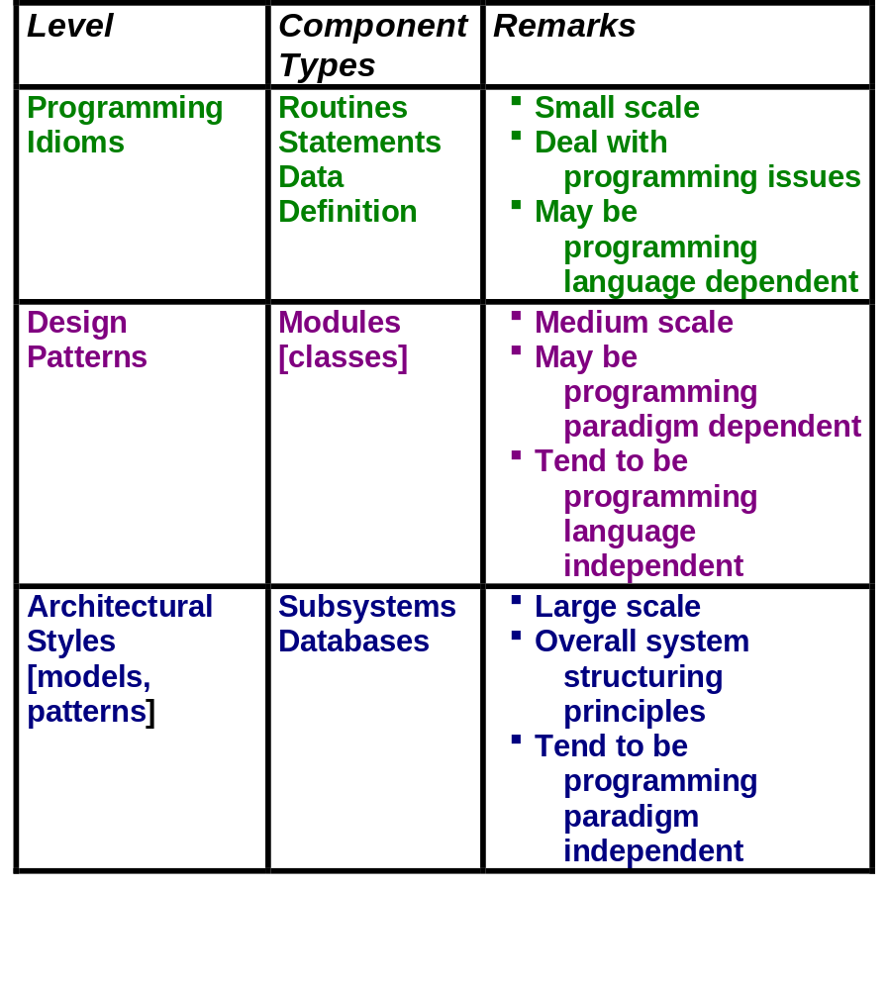
Pattern Levels

Slide 29
Architectural Patterns
Architectural patterns consist of
A set of component types that perform some function at run time
A set of connector types that provide a basis for communication, coordination or cooperation
A topological layout of these components indicating their runtime relationships
A set of constraints on allowable behavior
Note: An architectural style is not an architecture!

Slide 30
Architectural Patterns
Decomposition, structure, data and control flow of a system may be based on a particular architectural style
However, most real-world systems are heterogeneous in that different parts of the system are based on different patterns
The architectural pattern used affects basic system characteristics such as performance, robustness, distribute-ability and maintainability of the system
Architectural patterns overlap

Slide 31
Architectural Patterns
Major architectural patterns
  Call-and-return
  Layered [abstract machine]
  Data Centered
  Data flow
  Heterogeneous
  Domain Specific Styles

Slide 32
Call-and-Return
Architecture Patterns
The earliest and one of the most dominant architectural styles of the past 30 years
Sub-styles have evolved
  main program and subroutine architecture [structured design]
  Remote procedure call
  Object-based
  Object-oriented

Slide 33
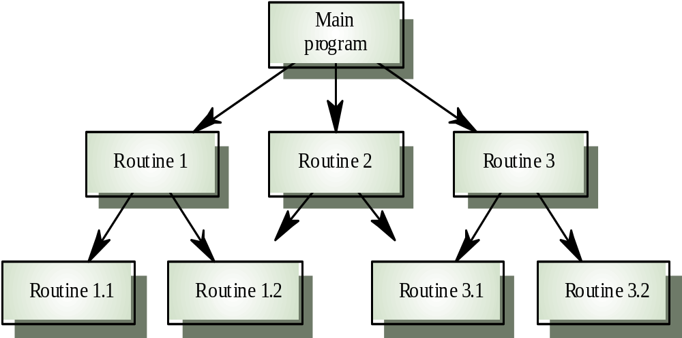
Main program and
subroutine architecture
top down subroutine model in which control starts at the top [main procedure] of the subroutine hierarchy and moves downward.
data is exchanged using parameters and global data
A single thread of control, applicable to sequential systems
Structured Design methodology - one of the first design methodologies

Slide 34
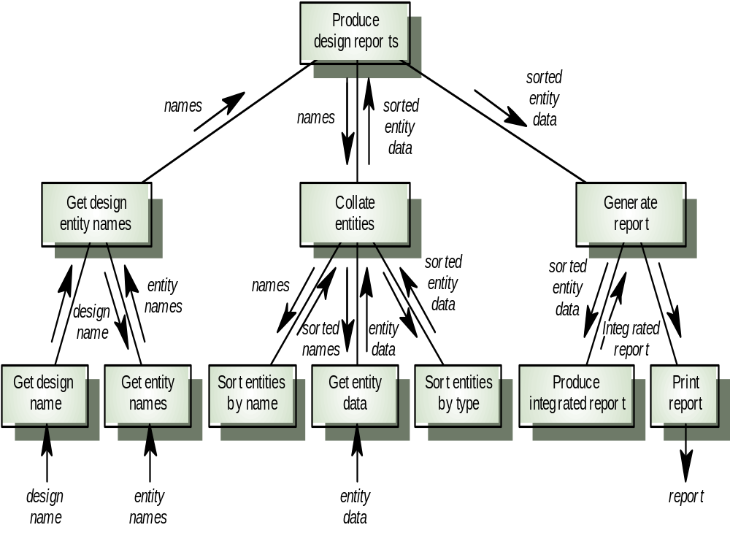
Example of main program
and subroutine architecture

Slide 35
Remote procedure call pattern
decomposition into procedures that live on computers connected via a network
the goal is to increase performance by distributing computations and taking advantage of multiple processors

Slide 36
Remote procedure call pattern
decomposition into procedures that live on computers connected via a network
the goal is to increase performance by distributing computations and taking advantage of multiple processors
subroutine calls may take longer, but otherwise similar to “normal” subroutine calls
Machine A
Machine B
Client
Proc A
Server
Proc B
Network

Slide 37
Remote procedure call pattern
decomposition into procedures that live on computers connected via a network
the goal is to increase performance or support required distribution by distributing the computations and taking advantage of mutiple processors
subroutine calls may take longer, but otherwise similar to “normal” subroutine calls
This led to Object Request Broker architectures [e.g., CORBA]
Machine A
Machine B
Client
Proc A
Stub
Stub
Server
Proc B
Network

Slide 38
Object-based/Object-oriented architectural pattern
Component types moved from procedures to modules providing information hiding

Slide 39
Object-based/Object-oriented architectural pattern
System
Subsystem
Subsystem
Subsystem

Slide 40
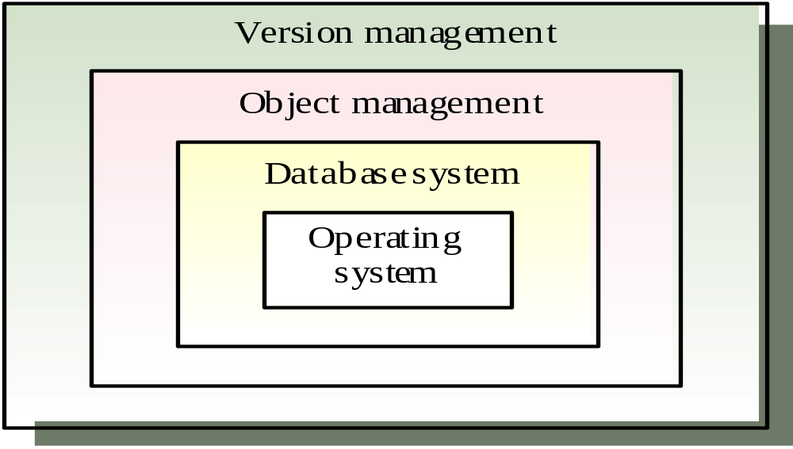
The Layered Architectural Style
Organizes the system into a set of layers (or abstract machines) each of which provide a set of services
Each layer communicates only with its immediate neighbors
The lowest [or innermost] layer provides some core functionality, such as hardware, an operating system or virtual machine
Each successive layer is built on its predecessor, hiding the lower layer and providing some services that its upper layers make use of
The uppermost [or outermost] layers provide services to the system’s external entities [i.e., users, clients, actors, other systems, hardware]
In practice, layered systems are not pure - functions in one layer may communicate with layers that are not its immediate neighbors, but this compromises the advantages of this style
Version Management System

Slide 41
Reference Model for
Open Systems Interconnection
[ISO OSI Architecture]
Example of a Layered Architecture
Application
inter-layer
interfaces
[service
access points]
Application
Presentation
Presentation
Session
Session
Transport
Transport
Network
Network
Data Link
Data Link
Physical
Physical
Physical Medium

Slide 42
Data-centered Architecture
This style is used for systems in which there is extensive access, update and/or exchange of data by its subsystems
In this case sub-systems may relate to data in two ways:
  Shared data is held in a central database or repository and may be accessed by all sub-systems
  Each sub-system maintains its own database and passes data explicitly to other sub-systems
When large amounts of data are to be shared, the repository model of sharing is most commonly used
  Passive Repository - controlled by the clients
  Active Repository [blackboard] - control is exerted by the blackboard by sending notification to subscribers when data of interest changes

Slide 43
CASE toolset architecture
Example of a Repository Pattern

Slide 44
Repository style characteristics
Advantages
  Efficient way to share large amounts of data
  Sub-systems need not be concerned with how data is produced Centralized management e.g. backup, security, etc.
  Sharing model is published as the repository schema
Disadvantages
  Sub-systems must agree on a repository data model. Inevitably a compromise
  Data evolution is difficult and expensive
  Difficult to distribute efficiently

Slide 45
The Data-Flow Architectural Style
based on a series of transformations on successive pieces of data
data flows through the components [subsystems] one at a time until they are assigned to some target [output or data store]
Batch
  processing steps are independent programs which are executed sequentially
  processing step runs to completion before the following step starts
  each batch of data is transmitted as a whole between steps
  used extensively in data processing systems [“JCL”]
Pipe and Filter
  emphasizes incremental transformation of data by successive components
  pipes exist to move data between filters
  a pipe has a source end that can only be connected to a filter’s output port and a sink end that can only be connected to a filter’s input port
  filters are black-box transformations that can be composed [of smaller pipes and filters]

Slide 46
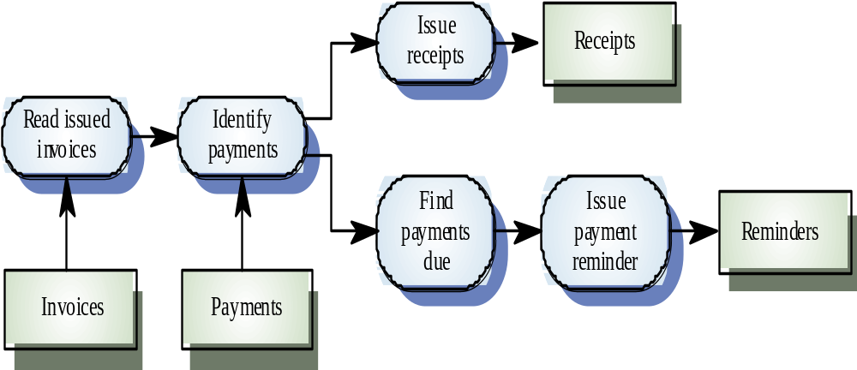
Example of the Data-Flow Architectural Style
Invoice processing system

Slide 47
Client-server architecture
Distributed system model in which data and processing are distributed across a range of computing elements
Set of stand-alone servers which provide specific services such as printing, data management, etc.
Set of clients which call on these services
Network which allows clients to access servers
Shares organization with call-and-return and layered styles

Slide 48
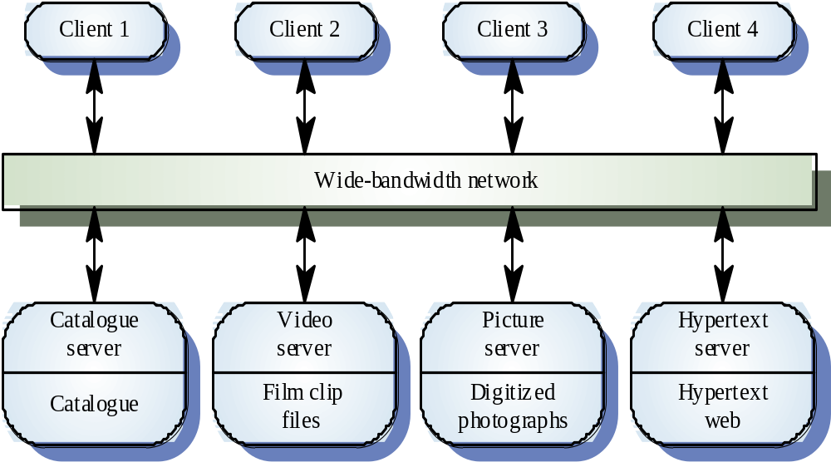
Film and picture library
Example of client-server architecture

Slide 49
Heterogeneous Architectures
Most systems are heterogeneous in that different parts of the system are based on different patterns
  locationally heterogeneous -
    different patterns in different areas
  hierarchically heterogeneous -
    a component of one style is structured using another style
  simultaneously heterogeneous -
    characterized by more than one style [I.e., styles do not divide sw architectures in mutually exclusive categories]

Slide 50
Characterizing an Architectural Style
Parts -
  the kinds of components and connectors used in the style
Control -
  how control is organized, allocated and transferred among the components
Data -
  how data is communicated between the system’s components
Data/Control Interaction -
  how data and control interact

Slide 51
Characteristics of Architectural Styles
Parts
  components
  connectors
Control Issues
  topology
    linear, acyclic, hierarchical, star, arbitrary
  synchronicity
    lockstep, synchronous, asynchronous, opportunistic
  binding time
    write, compile, invocation, run-time
Data Issures
  topology
  continuity
  mode
  binding time
Control/Data Interaction Issues
  Shape
  Directionality

Slide 52
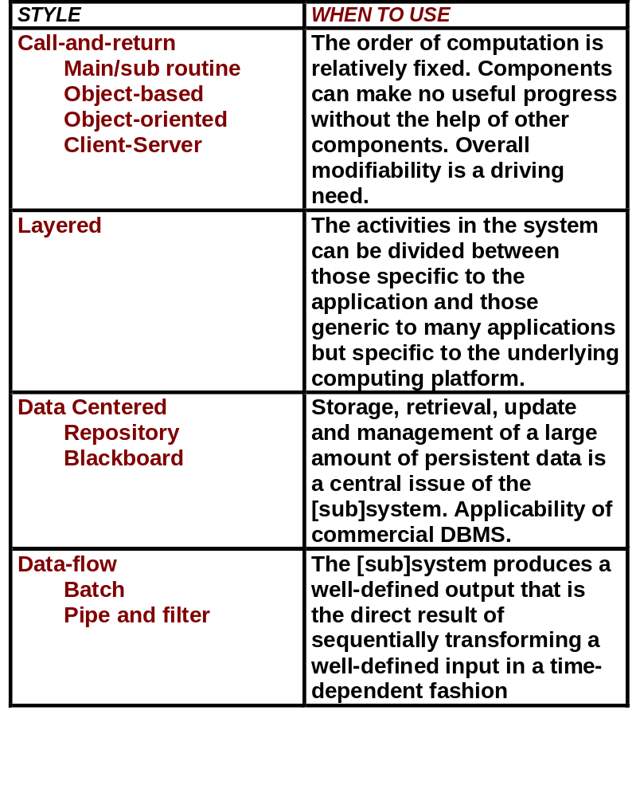
Guidelines for Selecting an Architectural Style

Slide 53
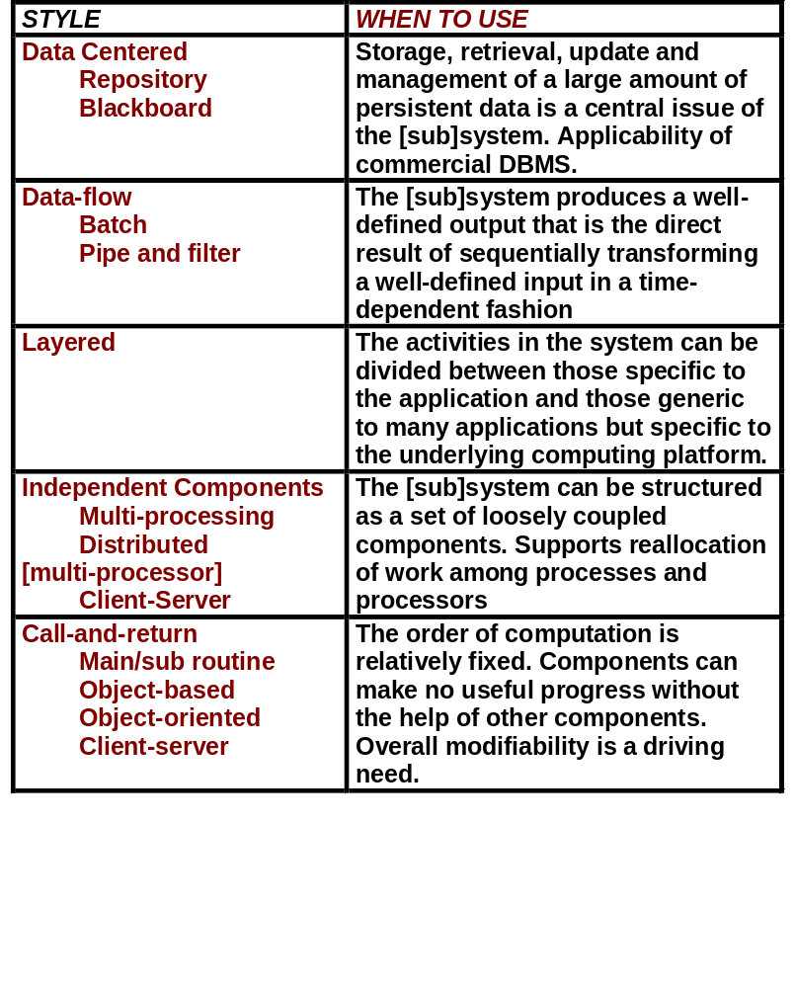
Guidelines for Selecting an Architectural Style

Slide 54
Domain-specific architectures
Architectural models which are specific to some application domain
Reflect the collective experience of the specific sw design community
Abstracted from a number of real systems and capture the principal characteristics of these systems
Provide a set of predefined subsystems, specifies their responsibilities, provides guidelines for defining the interactions between them [e.g., data flow, control flow]
Like any other architecture, they may be based on one or more architectural styles
Examples
  compiler design
  application generators
  process control
  communications systems
  ...

Slide 55
Canonical architectural models
Compiler model is a well-known example although other models exist in more specialized application domains
  Lexical analyzer
  Symbol table
  Syntax analyzer
  Syntax tree
  Semantic analyser
  Code generator
Generic compiler model may be organized according to different architectural models

Slide 56
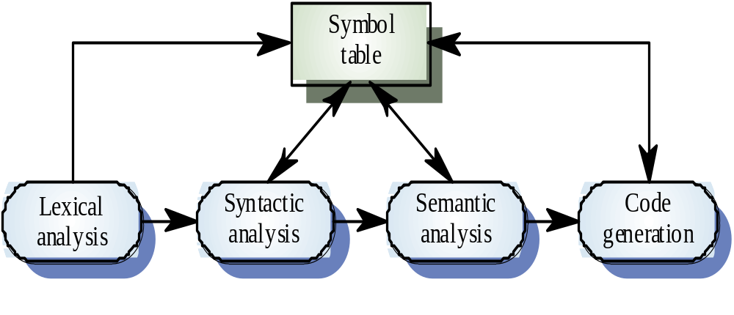
Compiler model
Example of canonical architectural models

Slide 57
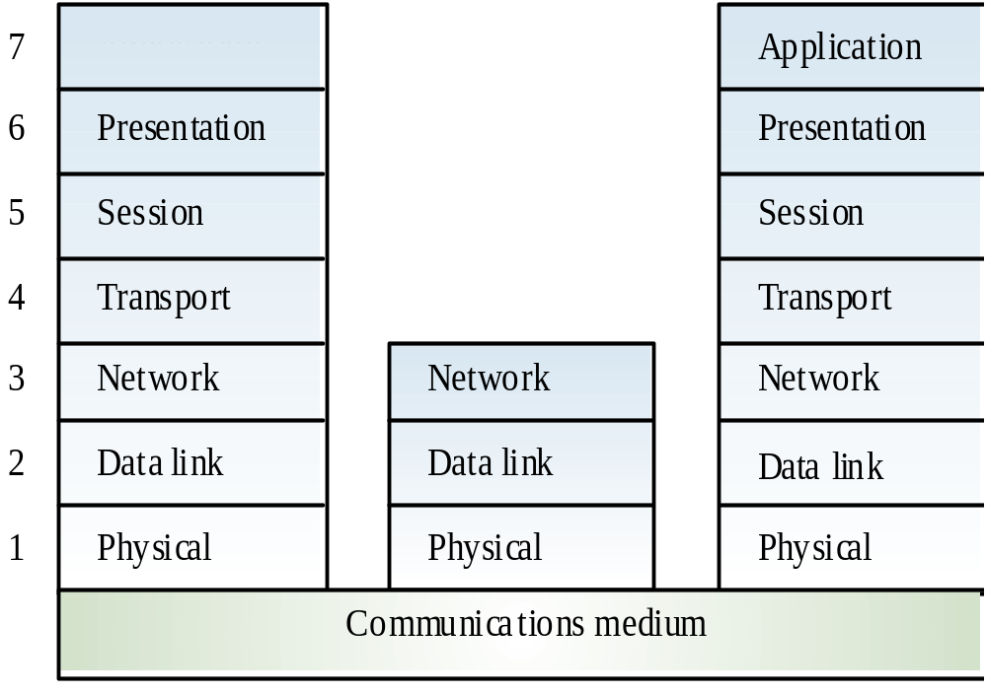
OSI reference model
Example of Canonical architectural models

Slide 58
Process Control Architecture
Closed-loop Architecture
input variables
Process
controlled variable
Control
signal
Controller
Set point

Slide 59
Process Control Architecture
Closed-loop Architecture
input variables
Process
controlled variable
Control
signal
actuator
subsystem
Controller
control
subsystem
Sensor
subsystem
Set point

Slide 60
Process Control Architecture
input variables
Open-loop
System
Process
controlled variable
input variables
Closed-loop
System
Process
controlled variable
Control
signal
Controller
Set point

Slide 61
Process Control Architecture
input variables
Open-loop
System
Process
controlled variable
input variables
Closed-loop
System
Process
controlled variable
Control
signal
actuator
subsystem
Controller
control
subsystem
Sensor
subsystem
Set point

Slide 62
References
Software Architecture - Perspectives on an Emerging Discipline,
Shaw and Garlan, Prentice-Hall.
Software Architecture in Practice,
Bass, Clements and Kazman, Addison Wesley
Pattern Oriented Software Architecture,
Buschmann, Meunier, Rohnert, Sommerlad, and Stal,
John Wiley
The Unified Modeling Language User Guide,
Booch, Rumbaugh and Jacobson, Addison-Wesley
The 4+1 View Model of Architecture,
Krutchen, IEEE Software, November 1995.
Comparing Architectural Design Styles,
Shaw, IEEE Software, November 1995.

Slide 63
Outline
Architectural Design Components
  Subsystems
  Modules
  Routines
Architectural Design Process
The Subsystem Level
  Subsystems
  Sub-system decomposition and structuring
  Architectural Design Patterns
  Domain Specific Architectures
The Module Level
  Modules
  Modular decomposition and structuring
  Module Taxonomy

Slide 64
SW Design Components

Slide 65
Introduction to Modules
Routines
Functional black boxes
Granularity Too Small
Languages:
  Fortran , Algol, PL/I, Pascal, C
Building Blocks of Structured Design
Decomposition Criteria
  functional decomposition
Modules [Packages]
Collection of program entities
  constants
  types
  variables
  routines
Distinguishes between
  public entitites
  private entitites
Languages:
  Ada, Modula-2, C++, Java
Building Blocks of
  Object-based design
  Object-oriented design
Decomposition criteria
  localization
  abstraction/ information hiding
  concurrency

Slide 66
Module - The Public Side
routine
spec
routine
spec
routine
spec

Slide 67
Module - The Private Side
Module-level
data
routine
spec
routine
body
routine
body
routine
spec
routine
body
routine
body
routine
spec
routine
body
routine
body

Slide 68
Architectural Design Process
Establishing the overall structure of a software system
Sub-system decomposition and structuring
  The system is decomposed into several principal sub-systems
  interfaces and communications between these sub-systems are identified
  control relationships between the different parts of the system is established
  logical database schema is defined for persistent data
Modular decomposition and structuring
  The identified sub-systems are decomposed into modules
  modules are specified in terms of their exported services
  “uses” relationships between modules are defined
  tasks [i.e., processes, threads of control] are identified

Slide 69
Object-Based Design -
Context Diagram
System

Slide 70
Object-Based Design -
Architectural Design
System
Subsystem
Subsystem
Subsystem

Slide 71
Object-Based Design -
Architectural Design
System
Subsystem
Subsystem
Subsystem

Slide 72
Object-Based Design -
Architectural Design
System
Subsystem
Subsystem
Subsystem

Slide 73
Object-Based Design -
Architectural Design
System
Subsystem
Subsystem
Subsystem

Slide 74
Object-Based Design -
Detailed Design
decomposition into routines
inter-routine commmunication
module-level data structures
System
Subsystem
Subsystem
Subsystem

Slide 75
Object-Based Design -
Internal Routine Design
System
Subsystem
Subsystem
Subsystem

Slide 76
Introduction to Modules
Routines
Functional black boxes
Granularity Too Small
Languages:
  Fortran , Algol, PL/I, Pascal, C
Building Blocks of Structured Design
Decomposition Criteria
  functional decomposition
Modules [Packages]
Collection of program entities
  constants
  types
  variables
  routines
Distinguishes between
  public entitites
  private entitites
Languages:
  Ada, Modula-2, C++, Java
Building Blocks of
  Object-based design
  Object-oriented design
Decomposition criteria
  localization
  abstraction/ information hiding
  concurrency

Slide 77
Module Taxonomy
concurrency criteria
  active
  monitor
  simple
cohesion criteria
D L A A A A
D I D D T T
B O T T
LEGEND
DD - Data Dictionary
LIB - Library
ADO - Abstract data object
ADT - Abstact Data Type
AT - Abstact Task
ATT - Abstract task type

Slide 78
Decomposition Criteria -
Localization
Package logically related entities
  - Constants
  - Types
  - Variables
  - routines
Logically related ---> physically related
data dictionary module - collection of related types and constants
library module - a collection of routines that provide a cohesive set of services with no common data
However - Localization does not exploit the specification\ implemention division

Slide 79
Example of Localization
package SMALL_FLOAT _QUEUE is
-- TYPES ---------------------------------------------------------------------------
SMALL_FLOAT_Q_SIZE: constant INTEGER := 100 ;
type Q_STATUS_TYPE is (EMPTY, FULL, OK) ;
type FLOAT_VECT is array (INTEGER range <>) of FLOAT ;
type Q_TYPE is
record
ELEMENTS: FLOAT_VECT (0..SMALL_FLOAT_Q_SIZE-1) ;
FRONT: INTEGER := 0 ;
BACK: INTEGER := SMALL_FLOAT_Q_SIZE - 1 ;
STATUS: Q_STATUS_TYPE := EMPTY ;
end record
type RTN_CODE_TYPE is (OK, OVERFLOW, UNDERFLOW);
-- THE QUEUE DATA STRUCTURE --------------------------------------
Q: Q_TYPE ;
-- OPERATIONS ----------------------------------------------------------------
function IS_EMPTY return BOOLEAN ;
function IS_FULL return BOOLEAN ;
function PUT (VAL: in FLOAT,
RTN_CODE out RTN_CODE_TYPE) ;
function GET (VAL: out FLOAT,
RTN_CODE out RTN_CODE_TYPE) ;
end SMALL_FLOAT_QUEUE ;

Slide 80
Problems with Localization
When used improperly localization can result in software that is
Insecure
Difficult to change and maintain
Costly to verify correctness
Costly to test
Overly complex

Slide 81
Information Hiding
The technique of encapsulating design decisions in modules in such a way that the module’s interface reveals only what the module’s users need to know.
Each module is a “black box” to the other modules in the system.
Information hiding forbids the use of information about a module that is not in the module’s interface specification.
An information hiding module hides some aspect of the system and is accessed by means of access (interface, public, ...) procedures or functions.

Slide 82
Abstract Data
application
update
insert
retrieve
delete

Slide 83

Abstract Device
A
B
On
Off
Blink
HW Interface Card
Interface Spec
1. To turn ON
Put 1 in bit 3
0 in bit 4
2. To turn OFF
Put 0 in bit 3
3. To Blink
Put 1 in bit 3
1 in bit 4

Slide 84
Abstraction / Information Hiding
application
abstraction package
data structure
device
file
...

Slide 85
Example of Abstract Data
package SMALL_FLOAT _QUEUE is
-- TYPES
type RTN_CODE_TYPE is (OK, OVERFLOW, UNDERFLOW);
-- OPERATIONS
function IS_EMPTY return BOOLEAN ;
function IS_FULL return BOOLEAN ;
function PUT (VAL: in FLOAT,
RTN_CODE out RTN_CODE_TYPE) ;
function GET (VAL: out FLOAT,
RTN_CODE out RTN_CODE_TYPE) ;
end SMALL_FLOAT_QUEUE ;

Slide 86
Limitations of ADO’s
what happens when two tasks running concurrently request service from the same module ?
need for multiple instances of the same module !
need for parametrization of modules !
  queue of integers
  queue of employee records
  queue of task control blocks

Slide 87
Intra - Module Concurrency
ado in a multi - tasking environment
race conditions
mutual exclusion at client level
mutual exclusion at server level
monitor
blocking routine semantics
multiple read / single write

Slide 88
Intra - Module Concurrency
System
Subsystem
Subsystem
Subsystem

Slide 89
Intra - Module Concurrency - at server side
System
Subsystem
semaphore
seize
release
Subsystem
Subsystem

Slide 90
Intra - Module Concurrency - at client side
System
Subsystem
Subsystem
Subsystem
monitor
semaphore
seize
release

Slide 91
Limitations of ADO’s
what happens when two tasks running concurrently request service from the same module ?
need for multiple instances of the same module !
need for parametrization of modules !
  queue of integers
  queue of employee records
  queue of task control blocks

Slide 92
Example of Abstract Data Types
package FLOAT _QUEUE is
-- TYPES
type Q_TYPE (Q_SIZE: NATURAL) is limited private ;
type RTN_CODE_TYPE is (OK, OVERFLOW, UNDERFLOW);
-- OPERATIONS
function IS_EMPTY (Q: in Q_TYPE) return BOOLEAN ;
function IS_FULL (Q: in Q_TYPE) return BOOLEAN ;
function PUT ( Q: in out Q_TYPE,
VAL: in FLOAT,
RTN_CODE out RTN_CODE_TYPE) ;
function GET ( Q: in out Q_TYPE,
VAL: out FLOAT,
RTN_CODE out RTN_CODE_TYPE) ;
private
...
...
...
end FLOAT_QUEUE ;

Slide 93
Abstract Data Types
generalization of data abstraction to provide multiple instances of the same abstraction.
new instances are created via declarations or constructor operations.
memory allocation at user’s expense.
representation detail is still hidden.
types can be parametrized
variables
abstraction
abstract
data objects
instantiation
instantiation
built-in
types
abstraction
abstract
data types

Slide 94
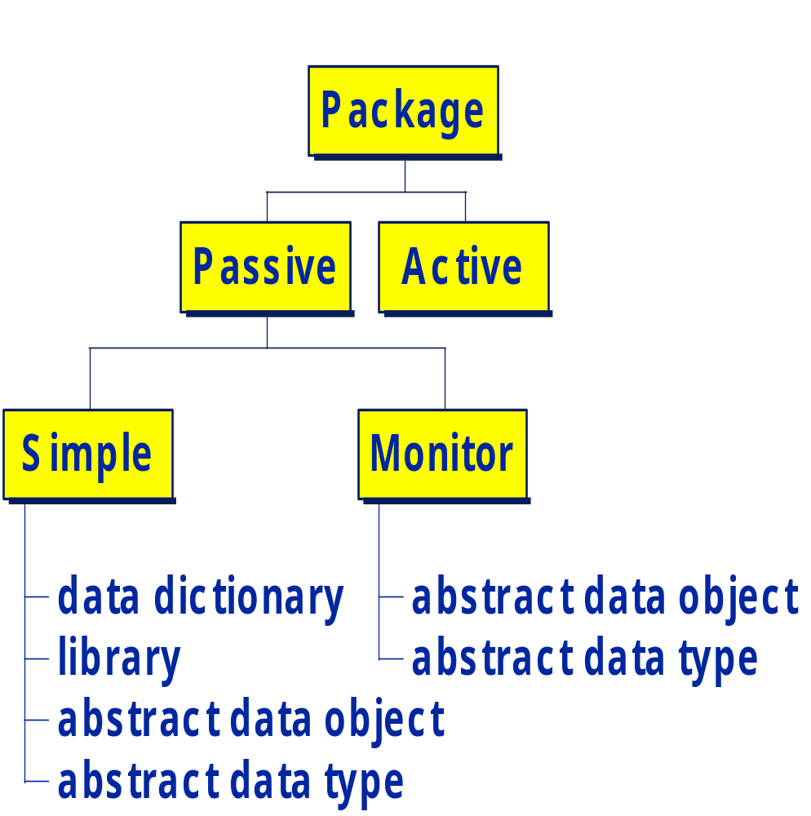
Interim Summary -
Module Classification

Slide 95
Inter - Module Concurrency
1. Why Concurrency ? ? ?
2. Transformational vs. Reactive Systems
3. Basic Concepts
  tasks
  environment-task communication
  task-task synchronization/communication

Slide 96
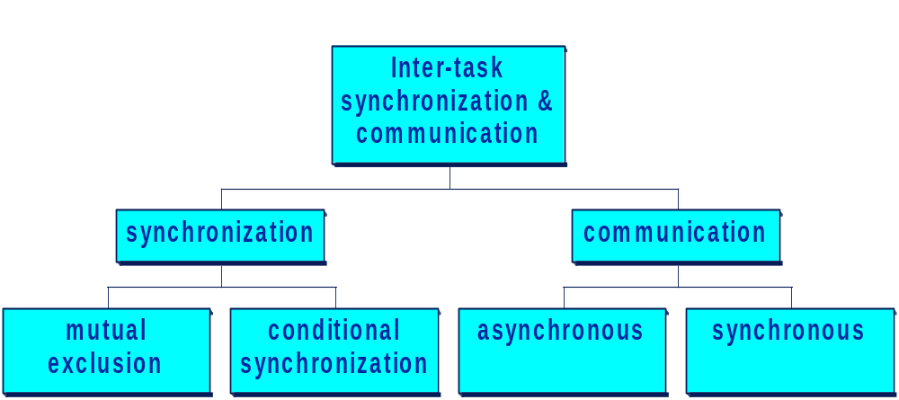
Inter - Module Concurrency
1. Why Concurrency ? ? ?
2. Transformational vs. Reactive Systems
3. Basic Concepts
  tasks
  environment-task communication
  task-task synchronization/communication
semaphore
mailbox
rendezvous

Slide 97
Task Structuring Guidelines
Assign a task (or ISR) to
  physical devices or activities
  periodic activities
  asynchronous activities
  concurrent system activities
  activities with different scheduling characteristics.
Group activities that are executed sequentially into one task.
Do not use tasking
  to define work assignments.
  to structure the software.
Take implementation constraints [e.g., performance] into consideration.

Slide 98
Task Structuring Guidelines
Assign a task (or ISR) to each physical device or activity.
Assign a unique task to each periodic activity.
Assign task to each asynchronous activity.
Assign a task to each distinct concurrent system activity.
Group activities that are executed sequentially into one task.
Assign tasks to activities with different scheduling characteristics.
Do not use tasking to define work assignments.
Do not use tasking to structure the software.
Take implementation constraints into consideration.

Slide 99
Abstract Tasks
x,y,z
[x,y,z]

Slide 100
Abstract Tasks
explicit
task
x,y,z
[x,y,z]
abstract
task
x,y,z
[x,y,z]

Slide 101
Advantages of Abstract Tasks
- hide operating system dependencies
  mailboxes, semaphores, etc.
  improves portability, reuse
- pl specification of process’s services
  formal specification
  type checking
- delay commitment to service concurrency
- change service concurrency
- transparent task distribution

Slide 102
Summary -
Diagramming Notation
simple
package
A
A uses B
B
monitor
package
mailbox
task
active
package
synchronous
communication

Slide 103
Summary - the Public and
Private Sides of a Module
Modules Export Services
constants
types
variables
routines
  sequential semantics
  blocking semantics
  asynchronous semantics
Modules Hide Design Decisions
algorithms
complex data structures
external data [inputs and outputs]
type representation
hardware dependencies [devices]
synchronization mechanisms
concurrency
distribution
operating system dependencies
areas likely to change with time
units of reusability

Slide 104
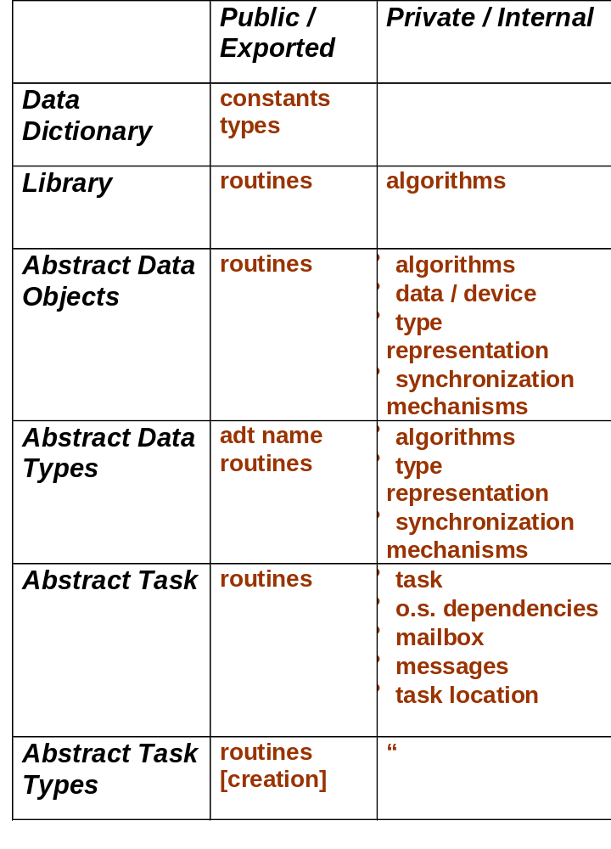
Sumary -
Module Cohesion Criteria

Slide 105
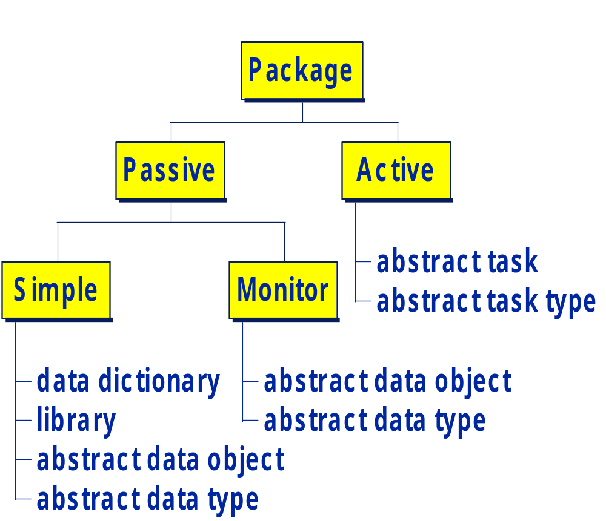
Summary -
Package Concurrency Classification

Slide 106
Summary -
Module Taxonomy
concurrency criteria
  active
  monitor
  simple
cohesion criteria
D L A A A A
D I D D T T
B O T T
LEGEND
DD - Data Dictionary
LIB - Library
ADO - Abstract data object
ADT - Abstact Data Type
AT - Abstact Task
ATT - Abstract task type

Slide 107
References
Parnas, “On the Criteria to be Used in Decomposing Systems into Modules,” Communications of the ACM, December 1972.
Gomaa, Software Design Methods for Concurrent and Real-Time System,
Addison-Wesley.
Gomaa, “A Software Design Method for Real-Time Systems,” Communications of the ACM, September 1984.
Shumate and Keller, Software Specification and Design - A Disciplined Approach for Real-Time Systems,
John Wiley.
Robinson, Object-Oriented Design, Chapman & Hall.

Slide 108
Extras

Slide 109
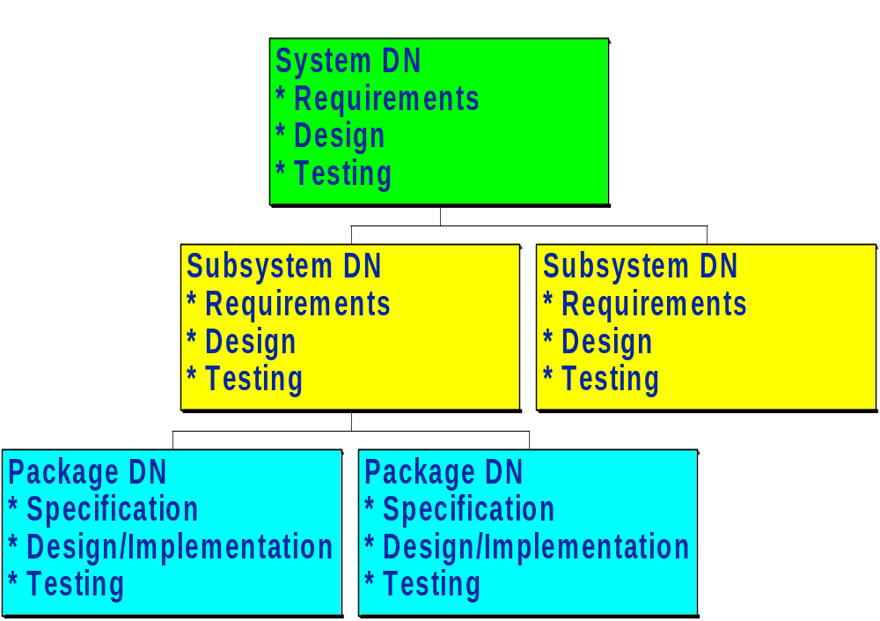
ISEF Software Development Library
The ISEF software development library is a hierachy of automated “development notebooks”, each of which is divided into chapters as illustrated below.

Slide 110
Task Structuring Criteria
I/O TASK STRUCTURING CRITERIA
  ASYNCHRONOUS DEVICE I/O TASK
  PERIODIC I/O TASK
  RESOURCE MONITOR TASK
INTERNAL TASK STRUCTURING CRITERIA
  PERIODIC TASK
  ASYNCHRONOUS TASK
  CONTROL TASK
  USER/ROLE TASK
TASK COHESION CRITERIA
  TEMPORAL COHESION
  SEQUENTIAL COHESION
  FUNCTIONAL COHESION
TASK PRIORITY CRITERIA
  TIME - CRITICAL
  NON - TIME_CRITICAL
.

Slide 111
Abstract Data
Data
  complex data structures
  external data
  input\output devices
Defined in Behavioral Terms
  in terms of allowed operations
  hides representation details
  localizes representation details
Representation
  structural
  algorithmic
  synchronization

Slide 112
Limitations of ADO’s
what happens when two tasks running concurrently request service from the same module ?
need for multiple instances of the same module !
need for parametrization of modules !
  queue of integers
  queue of employee records
  queue of task control blocks
variables
abstraction
abstract
data objects
instantiation
instantiation
built-in
types
abstraction
abstract
data types

Slide 113
Development Techniques
Entity Relationship Modeling
Use Cases
Interaction Diagrams
Statecharts
Structured Analysis
Structured Analysis/RT

Slide 114
Design
Design styles involves establishing
  allowable kinds of components
  connectors
  control
  data
  control/data interaction

